Slide 1
Submitted To : Name : Md. Imran Hossain Assistant professor Department of ICT Comilla University
Submitted By:
Name : Nusrat Jahan Abrar
ID No : 11809026
Department of ICT Comilla University

Slide 2
Simplified Monochrome Television Transmitter
Contents :
Monochrome Television.
Monochrome TV Transmitter.
Elements of Monochrome Television Transmitter.
Block diagram of Monochrome Television Transmitter.

Slide 3
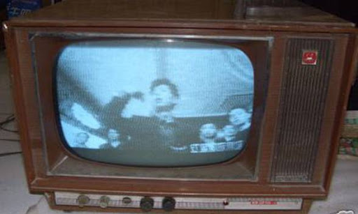
Monochrome Television: TV is the central element of audio and video setup and in which television the final reproduced picture is monochrome, having only shades of gray between black and white is called Monochrome Television. Also known as black-and-white television.
Fig : Monochrome Television

Slide 4
Elements of Monochrome Television Transmitter
Camera Tube.
Synchronizing and scanning circuits.
Amplifier.
Modulator.
Crystal Oscillator.
RF amplifier.
Antenna.

Slide 5
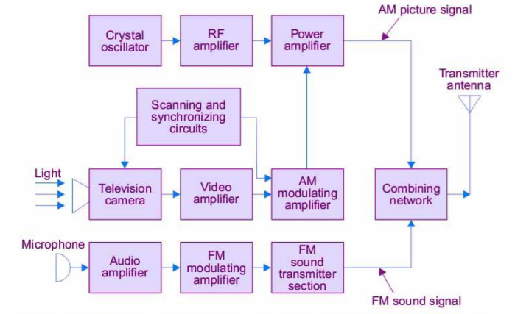
Fig: Simplified block diagram of Monochrome Television Transmitter

Slide 6
Thank you

